Slide 1

Garden Mulcher!
By Troy Alatise!

Slide 2
What's the name of the game?
A mysterious creature has been wreaking havoc in every and all gardens! Eating all the vegetables and showing no mercy while doing it! Play as this savage garden destroyer as you roam through the garden, making mincemeat of this fine patch of vegetables.
The creature navigates gardens, leaving no leaf whole as it makes sure to not miss any veggies along the path in search of the rare FIREFRUIT! (I know this is a game about veggies, but I prefer the alliteration)
After eating enough garden slop, the creature can call for an ally to take its place while it ruins other people's day and send them in to raid the next garden.

Slide 3


Why is the garden mulching?
The mysterious creature comes from a faraway land and seems to have taste for only veggies, it may seem like it's only out to see veggies' guts spill, but an ulterior motive is present.
You see, the creature and its kind use the firefruit to power their land, but humans harvested them all, forcing them to migrate collectively. Now they are out for justice and want to rid the human race of firefruit by robbing them all. The mass veggie theivery is just a sweet, sweet bonus.

Slide 4
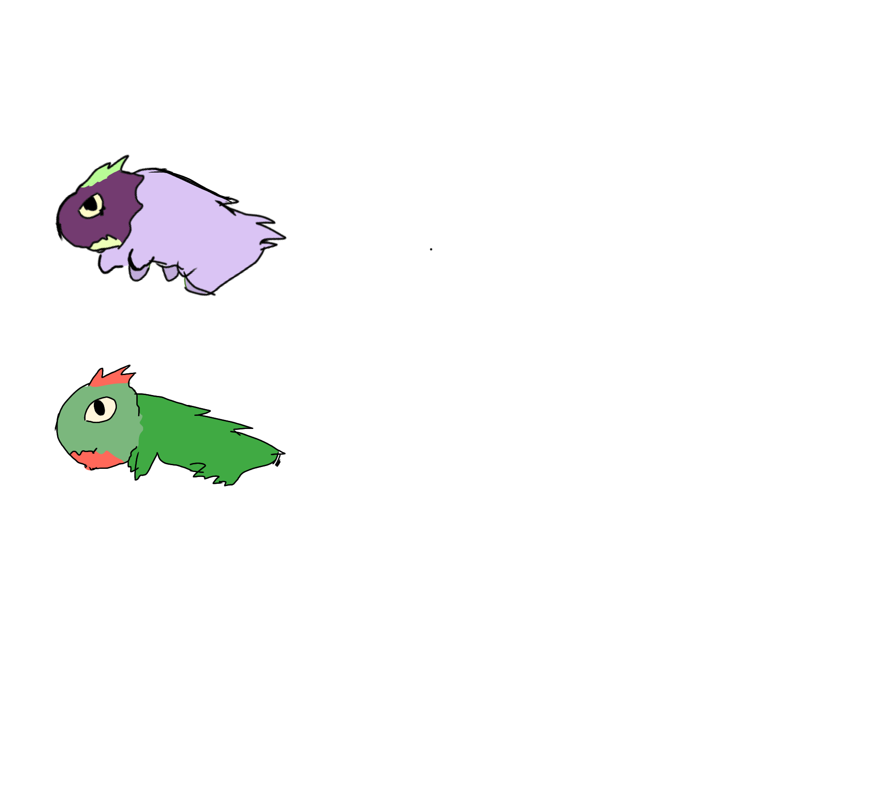
Handdrawn picture of what the creature would look like :]

Slide 5

Ahead of the game!
So, how do you play? Well, that's simple. You use the keyboard to move left and right and jump to catch the veggies before they land on the ground. There are five different vegetables that can fall.
Cabbage
Corn
Carrot
Cucumber
Cauliflower
Each of them is worth 1 point and the type of veggie that will fall is completely randomized at equal chance However, the special fire fruit. However, the firefruit is a different case, it is worth five points as opposed to 1 and is very rare, dropping much less frequently than all the other veggies. The veggies will drop quicker as time goes on. I has a speed cap though.
There will be some veggies that will give the player powerups, to move faster or jump higher

Slide 6



More gameplay yap!
Player has three lives, every time player misses a veggie, they lose a life, when they lose all three lives, they are greeted with a 'game over' screen.
Once the player loses, they are sent back to menu, if they manage to accumulate enough points in one sitting, they unlock a new skin for the playable character and are able to change skin.

Slide 7
Garden Mulcher's gameplay elements
Left/Right movement
Jump!
Customization

Slide 8

Garden Mulcher's gameplay elements
Left/Right Movement = 48%
The veggies will fall from either the left, right or middle, the player is expected to navigate the mulcher and move from left to right to catch the veggies (do not ask why the veggies are falling)
Jump! = 38%
The player needs to actually catch the veggies before they fall to the ground, or they will not count towards their score. This is the main element of the game alongside the movement
Customization = 14%
Every veggie you get goes towards your score, when you reach a certain number of points in a game, there will be skins for the creature as milestones.

Slide 9
Skills involved in development
Classes[as far as the veggies go]
Arrays[for the veggies once again]
Source control[Git]
Graphic development[sprites for veggies and playable character, background design, interaction animations
Documentation[notes, design doc, concept, trial and error]
Teamwork makes the dreamwork!

Slide 10
Evaluation of Elements
Main Menu [0-15]
Preferably floral design with a specific sort of menu design: Game title in top middle with the Play button right below, skin button at the left and highscore button at the right.[10]
Visual Asset creation
Drawing of the creature and of each vegetable. [5]
Audio Asset Creation[0-10]
A lovely and peaceful main menu and gameplay theme as well as some jumping sound effects for the creature and maybe a celestial-esque sound for when the firefruit shows up.[10]

Slide 11

Adventures in the elements
Basic Gameplay[20] (Jump, left/right movement)
Graphics[20] (Sprites, text, font)
Video[5]
Project Management[5]
Advanced Gameplay [0-20] (Powerups, skin unlock system, highscore system)
Advanced Graphics [0-20] (Animation for eating animation for each veggie falling to the ground]

